Slide 1
Deep Learning for Unsupervised Insider Threat Detection in Structured Cybersecurity Data Streams
Aaron Tuor
w/ Brian Hutchinson, Sam Kaplan, Nicole Nichols, Sean Robinson
Notes:
I’m Aaron Tuor. Currently a graduate student at Western Washington University, expected to graduate in June 2017
The talk I am presenting today, stems from an ongoing collaboration between researchers at Pacific Northwest National Laboratory
And Western Washington University. This work began over the summer when I and Sam Kaplan were in the National Security Internship Program and Professor Brian Hutchinson was a visiting faculty working on the AIM-SAFE project.

Slide 2
Motivation
Insider Threat: Actions taken by an employee harmful to an organization
Unsanctioned data transfer
Sabotage of resources
Misuse of network that disrupts organization
Analysis of network activity can detect Insider Threat
Automated filtering can help reduce the analyst workload
Notes:
The problem this research specifically addresses is Insider Threat which can generally be defined as any actions taken by an employee harmful to an organization.
The day to day operations of many organizations are critically dependent on computer networks and the data which these networks host.
Insider threat can take a wide variety of forms often times related to the organizations computer network. such as unsanctioned data transfer, sabotage of resources, or a misuse of a network that disrupts the organization (Mass alarming emails).
The motivation of this research is that analysis of network activity can aid in the detection of insider threat but human analysts are faced with an overwhelming amount of real time data.
Automated fitering using a deep learning approach can help reduce the analyst workload.

Slide 3
Approach Constraints
Approach should provide:
Real time evaluation
Upper bound on storage requirements
Analysis of structured multivariate data
Adaptation to shifting distribution of activities
Interpretable assessments
Notes:
Any proposed approach to addressing the issue of filtering analyst workload must abide by several real world constraints.
First and foremost, for a filtering algorithm to be useful it should perform anomaly detection in real time.
Further there needs to be a limit on the storage requirements of the algorithm. Memory usage cannot be allowed to grow unbounded over time.
The model should be able to process a multivariate stream of data which may contain a mix of categorical and continuous variables gathered from several data sources.
The model must be able to adapt to a shifting distribution of activities as patterns of behavior may shift cyclically from week to week and day to day, or drift over time due to newly developing projects. what is normal on Monday may not be normal activity on Sunday, and what is normal at 8 am may not be the same as what is normal at 6 pm.
The model should provide interpretable assessments.
In order for the human analyst to gain trust in the system’s judgments, and learn from then, the model should be more than just a black box that flags events for investigation. It should provide some insight as to why some events are deemed anomalous and others as representative of normal activity.

Slide 4
System at a Glance
Raw “Events”
Feature Vectors
file
email
http
http
email
…
Feature Extractor
…
Neural
Network
Batcher / Dispatcher
…
Anomaly Scores
Notes:
Here is a graphic depicting the system.
As events are logged from different sources they are fed to a feature extraction module which maps the data into numeric feature vectors.
These feature vectors are then passed to a dispatching module which organizes the vectors into sequences of user activities.
Vectors are passed to a neural network model which then trains on them, outputting it’s loss for individual vectors as an anomaly score.
The anomaly scores can be ranked within a window of time, with the most anomalous events flagged for analyst inspection.
There are several different configurations which are available within this framework.
The input from multiple tracking sources can me mapped into either a single feature vector per log line or an aggregate feature vector
of compiled statistics over a window of time.
This input can be fed to either an deep or recurrent neural network for training.
The anomaly score the network produces can be generated by any of several probabilistic models for anomaly.
Finally our anomaly scores decompose into anomaly scores for individual features for analyst inspection.

Slide 5
Outline
Data processing and feature extraction
Deep learning architectures
Experiments and results
Takeaways and Continuing work
file
email
http
http
email
…
Feature Extractor
…
Notes:
Here is a brief outline of the structure of this talk.
First I will go over data processing and feature extraction. How we map data from various logging sources into numeric input for our neural network architectures.
Then I’ll go over the two neural network archtiectures we employ for this system, recurrent neural networks and deep neural networks.
Then I will review the experiments and analysis we conducted over the fall which led to a forthcoming publication for a AAAI-2017 workshop. I will finish with a discussion about what we accomplished and learned from this research, and future plans to develop this work.

Slide 6
Data Sources
CERT Insider Threat (version 6.2)
Synthetic data generated according to sophisticated user model
516 days, 135 million events total
Email, web, logon, file and device usage events
5 bad actors produce 470 threat events
Accompanying user meta data (role, project, team, …)
file
email
http
http
email
…
Notes:
The data set we used to develop the system and perform experiments is the Cert insider threat data set, version 6.2.
This is a synthetic data set generated by modelling user activity on a network and injecting expert designed insider threat events into
The normal activities.
There are 516 days of data and 135 million log lines in total.
The events are from five sources, email, web, logon, file and device usage logs.
The data set is accompanied by user meta data such as their role in the organization, the project they are assigned to and the team they are working with.

Slide 7
CERT: Example Log Line
Event ID | I102-B4EB49RW-7379WSQW
Date | 1/2/2010 6:36:41
User | HDB1666
PC | PC-6793
To | Louis.Bernard.Garza@dtaa.com
CC | Emery.Ali.Holloway@dtaa.com
BCC | Hector.Donovan.Bray@dtaa.com
From | Hector.Donovan.Bray@dtaa.com
Activity | Send
Size | 45659
Attachments | <none>
Content | Now Sylvia, the object …
Email
Event
Notes:
Here is an example of a log line from a log detailing email activity on the network.
From the various logging sources we propose two different methods for transforming log text to numeric feature vector.
Eventwise where individual log lines are transformed into a vector of categorical and continuous variables, and aggregate where statistics for the log lines for each user over a time window are collected into a vector for input to the neural network.

Slide 8

Aggregate Feature Vector
For each user, aggregate their events over a window of time (e.g. one day)
Example feature vector:
Categorical
Counts
http
http
http
http
http
${xt}_{u}$ =
19 | 3 | 281 | … | 8 | 23 | 47 | 29 | 35 | … | 8
logon
email
Project=“3”
email
email
Supervisor=“Carter Wells”
# Logons
file
# Web Downloads
file
Team=“Systems Engineering 20”
# Webpages Visited
device
Role=“ComputerScientist”
# Emails Sent w/ Att.
# File Writes
Notes:
Categorical variables are mapped to indices for the particular class for this data point. Trainable weights are looked up for each category before the vector is fed to the network.

Slide 9
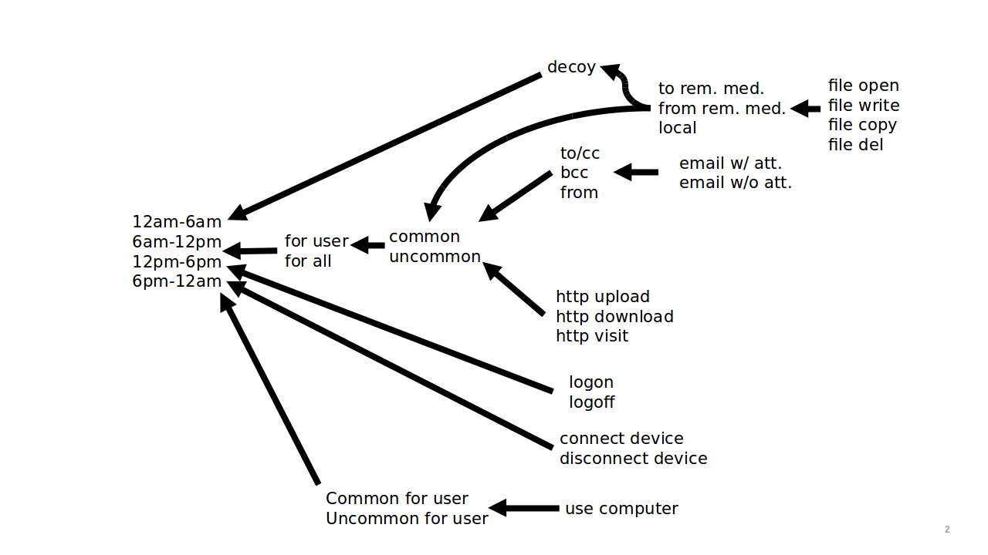
CERT Aggregated Features
Enumeration of 408 counted
“activities”
Notes:
Here is a “choose” one graph enumeration of the 408 counted activities used in aggregate feature derivation.
To enumerate a single counted activity simply follow a path from right to left, choosing one item in each set along the way. The set of all such traversals is the set of count features. For example we count the number of decoy file writes to removable media from the hours of 12am-6am.

Slide 10
Eventwise Feature Vectors
email
Event ID | I102-B4EB49RW-7379WSQW
Date | 1/2/2010 6:36:41
User | HDB1666
PC | PC-6793
To | Louis.Bernard.Garza@dtaa.com
CC | Emery.Ali.Holloway@dtaa.com
BCC | Hector.Donovan.Bray@dtaa.com
From | Hector.Donovan.Bray@dtaa.com
Activity | Send
Size | 45659
Attachments | <none>
Content | Now Sylvia, the object …
459 | 106 | 808 | 712 | 712 | 1 | 0
PC=“PC-6793”
Att=None
CC=“Emery…”
From=“Hector…”
To=“Loius…”
BCC=“Hector…”
Activity=“Send”
Notes:
Here is a picture of our eventwise feature derivation for a log line from the email log. We describe this event numerically as a vector of categorical indices.

Slide 11
Outline
Data processing and feature extraction
Deep learning architectures
Experiments and results
Takeaways and Continuing work
Neural
Network
Batcher / Dispatcher
…
Anomaly Scores
Notes:
Next I’m going to talk about the deep learning architectures that will be used to model normal user behavior on the network.

Slide 12









Deep Neural Network Autoencoder
$$y =f\left(U^{T}h_{L}+b\right)$$
Parametric function
Trained to reproduce input as output
Complexity is constrained to prevent learning identity function
Anomaly is detected when a poor reconstruction of an input is made by the model
output $y$
hidden layer $hL$
$$h_{i} =g\left(W_{i}^{T}h_{i−1}+a_{i}\right)$$
$$W1,a1$$
$$U,b$$
hidden layer $h1$
…
$$h_{1}=g\left(W_{1}^{T}x+a_{1}\right)$$
input $x$
Notes:
We explored two different neural network architectures in developing this system, one of which is a neural network autoencoder.
The basic idea behind a neural network auto-encoder is to map the input vector into a lower dimensional space using a series of non-linear
Transforms and then map this transformed input back into the original space using another linear transform.
The model is trained to reproduce the input as output.
As the complexity of the model is constrained it must learn to leverage underlying patterns in the data for a good reconstruction.
When the model is fully trained it should do a good job at reconstructing commonly found patterns in the data and a poor job at reconstructing unusual events.
When the loss of the network is high then anomaly is detected.
The loss of a standard autoencoder is typically the distance between the input and output vectors. For our multivariate input we use a more sophisticated probabilistic approach to detect anomaly which we will go over in a few slides. In a nutshell, The model outputs the multivariate distribution the data point came rather than the data point itself.

Slide 13














Deep Learning Architectures
output $y$
Output ($y$_{1,} y_{2,} …, $y$_{T})
hidden layer $hL$
hidden layer $hL$
Deep
Neural
Network
Deep
Recurrent
Neural
Network
$V$_{L,} $b$_{L}
$$W1,a1$$
$$U,b$$
$$W1,a1$$
$$U,c$$
hidden layer $h1$
hidden layer $h1$
…
…
$V$_{1,} $b$₁
input $x$
Input ($x$_{1,} $x$_{2,} …, $x$_{T})
Notes:
We also implemented a recurrent neural network variant for the system which takes as input sequences of user activity vectors rather than single user feature vectors fed to the deep neural network. The outstanding difference between the deep neural network and the recurrent neural network is that the hidden layers depend not only on x_t but also on the hidden state for that layer at the previous time step.

Slide 14












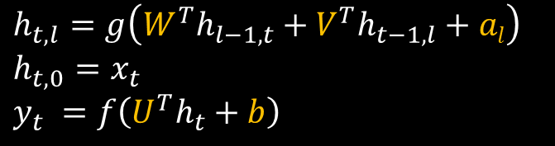


(Unrolled) Deep Recurrent Neural Networks
A deep RNN can be “unrolled” in time, so they are “deep” in two dimensions.
Weights are shared across time
…
…
$$h_{t,l}=g\left(W^{T}h_{l−1, t}+V^{T}h_{t−1,l}+al\right)$$
$h_{t,0}=$ $x_{t}$
$$y_{t} =f\left(U^{T}h_{t}+b\right)$$
$y$₁
$y$₂
$y$_{T}
$$h_{0,L}$$
$h1,L$
$h2,L$
$h$_{T,L}
layers
…
…
…
…
$h1,1$
$h2,1$
…
$hT,1$
$$h_{0,1}$$
$x$₁
$$x\text{2}$$
$x$_{T}
…
“Long Short-Term Memory” (LSTM)
RNNs provide better performance,
we use them instead
time
Notes:
It is easier to see what is going on in the RNN if we unroll the recurrence as shown here. We can see that our reconstruction now depends not only on the current input but also on a summary of past user activity represented in the hidden state vectors. For simplicity we show the graphic and equations of a basic RNN but in practice we use an RNN with Long Short Term Memory layers as this model has been shown to do better at modelling long term dependencies in time series.

Slide 15




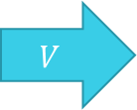
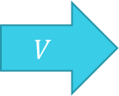
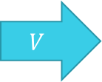






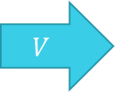



RNN Model Overview
Split events by user, model each user’s event sequence with RNN:
We train the model
to reconstruct the current
event in the sequence
or predict the next
$$y_{1}$$
$$y_{2}$$
$$y_{T}$$
Hidden vector
summarizes what we know so far about user
Anomaly is detected
when next input
deviates greatly from what we expected
$$h_{0}$$
$$V$$
$$h_{1}$$
$$V$$
$$h_{2}$$
$$V$$
…
$$V$$
$$h_{T}$$
$$W,a$$
$$W,a$$
$$W,a$$
$$x_{1}$$
$$x_{2}$$
$$x_{T}$$

Slide 16











Next Step Vs Autoencoder
Autoencoder prediction: $P\left(x_{t} | h_{t}\right)$
Next step prediction: $P\left(x_{t} | h_{t−1}\right)$
$$y_{t−1}$$
$$y_{t}$$
Bottleneck
only capable
of recovering
“normal” inputs
$$h_{t−2}$$
$$h_{t−1}$$
$$h_{t−1}$$
$$h_{t}$$
$$x_{t−1}$$
$$x_{t}$$
$$x_{t}$$

Slide 17






Concurrent training on multiple sequences
Get input for user
Load model state for user
Reconstruct input to detect anomaly
Save state of model for user
$$y_{t}^{(k)}$$
$$h_{t}^{(k)}$$
$$h_{t+1}^{(k)}$$
$$x_{t}^{(k)}$$
…
$$h_{t−1}^{(k)}$$
$$h_{t}^{(k)}$$
$$h_{t+1}^{(k)}$$
Notes:
The standard method for training an RNN is to feed fixed length sequences of vectors to the model and adjust the model weights through gradient descent using backpropagation after each sequence has been observed.
However the normal paradigm for training an RNN breaks down in the online scenario.
Our sequences of user activity vectors are effectively unbounded so we cannot apply the standard method.
Instead we concurrently train the network on all the user sequences as we perform anomaly detection by saving the hidden state of the network for each user sequence as new data points arrive We have all of these long lines streaming in that we are turning into feature vectors.
Rather than treat the incoming feature vectors as a single homogenous sequence, we view the stream as a set of interleaved sequences, one for each user on the network.
The goal of our system is to concurrently train a single RNN on many sequences.
We are able to do so by saving the state of the model each time a user is encountered. And then restoring the state of the model when that user is seen again.
Four steps:
Get input for user
Load model state for user
Reconstruct input to detect anomaly
Save state of model for user

Slide 18












Predicting Structured Events
Want to compute $P\left(x_{t} | h_{t}\right)$ to quantify anomaly
How? Depends on the structure of $x_{t}$
Example:
$$y_{1}$$
$$y_{2}$$
Categorical
Counts
$$h_{1}$$
$$V$$
$$h_{2}$$
$x_{t}$ =
19 | 3 | 281 | 8 | 23 | 47 | 29 | 35 | … | 8
$$W,a$$
$$W,a$$
P
C
$$x_{1}$$
$$x_{2}$$
S
T
Need to compute $P(R,P,T,S,C|h_{t})$
R
Notes:
The input to the network (our targets for reconstruction prediction) are assumed to come from an unknown multivariate distribution consisting of a mix of categorical and continuous random variables, which our network must learn to model. We want to compute the probability of an event to quantify anomaly.

Slide 19






Predicting Structured Events
First, we decompose the joint probability (assume independence)
$P\left(R,P,T,S,C | h_{t}\right)≈P\left(Role | h_{t}\right)P\left(Project | h_{t}\right)P\left(Team | h_{t}\right)⋯P(Counts|h_{t})$
The output y vectors are either a distribution (for categorical input) or the parameters of a multivariate normal distributions (for vector of continuous input features).
$$y_{t}^{R}$$
$$y_{t}^{P}$$
$$y_{t}^{C}$$
$$⋯$$
$$h_{t}^{}$$
Notes:
Our neural network turns out to be a probability distribution factory. The weights are trained on data points to output the probability distribution they came from.
For categorical inputs the output of the model is a discrete probability distribution. We apply a linear transform to the hidden state to map to a vector the length of the number of classes and then apply the softmax function to get a distribution. For our vector of continuous inputs the output of the model are the parameters of a multivariate guassian probability density function.

Slide 20





Predicting Structured Events
We need to choose parametric forms for each $P\left(X | …\right)$
For categorical variables, we define $y∈ℝ^{C}$ so that
$P\left(X=i\right)=y_{i}$, where $y_{i}=softmax\left(U^{T}h+b\right)$
For “continuous” variables, we let $y=U^{T}h+b$ and
$$P\left(X=x\right)= N(x;μ\left(y\right), Σ\left(y\right))$$
$$y_{t}^{R}$$
$$h_{t}^{}$$
$$y_{t}^{C}$$
$$h_{t}^{}$$

Slide 21

Predicting Structured Events: MVN
We consider three forms of multivariate normal (MVN) distribution:
Option 1: Identity Covariance
$y=μ$
Option 2: Diagonal Covariance
$y=[μ,\log\left(σ^{2}\right)]$, and $Σ=diag(σ^{2})$
Option 3: Full Covariance
$y=[μ,v]$, where $v=V(:)$, $V$ is lower triangular and $Σ=VV^{T}$
Notes:
If we take the standard auto-encoder approach for training a model (a squared error loss between the input and output) we are effectively assuming that the data can be modelled with a multivariate normal distribution with an identity covariance matrix.
We can model a wider range of distributions by allowing our model to output the parameters to less restricted multivariate distributions. Adding more modelling power could make it more difficult to train. The first relaxation of restrictions is to output a diagonal covariance along with the mean of the distribution. The second is to output a full covariance matrix along with the mean vector.

Slide 22








Training and Anomaly Detecition
Multivariate loss
(Anomaly score)
P_{R} | P_{T} | … | … | … | µ_{C} | Σ_{C}
$$y_{t}^{R}$$
$$y_{t}^{P}$$
$$⋯$$
$$y_{t}^{C}$$
$$h_{L}^{}$$
$$⋯$$
$$h_{1}^{}$$
${xt}_{u}$ =
r | t | … | … | … | 23 | 47 | 29 | 35 | … | 8
Categorical
Counts
Notes:
After each event $x_{t}$ arrives…
Measure anomaly of the event
Update all model weights to increase $\log{P\left(x_{t} | h_{t}\right)}$
Model trains and detects anomaly in a purely online fashion…

Slide 23
Outline
Data processing and feature extraction
Neural networks and our model
Experiments and results
Takeaways and continuing work

Slide 24
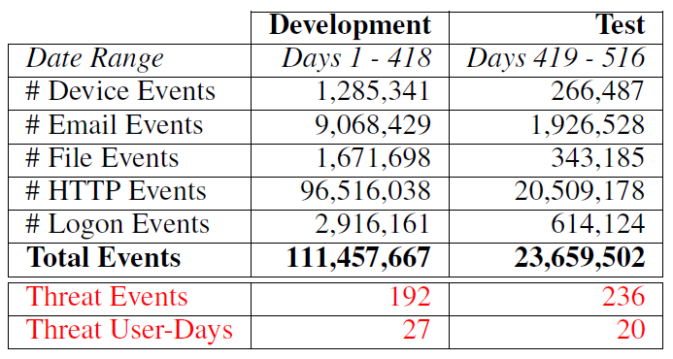
Experiment Setup
Split data set into train/dev and test
Test model configurations on range of hyper parameters
Test best model configurations against standard anomaly detection techniques
Notes:
Since this is an unsupervised task, no supervised training set is required. So we split the entire dataset chronologically into two subsets: development and test. The development set (∼85% of the data) is used for model selection and hyper-parameter tuning, while the test set (∼15% of the data) is held out for assessing generalization performance. This table summarizes the dataset statistics. More threat user days than threat events as on some days a single user may perform several threat activities.

Slide 25
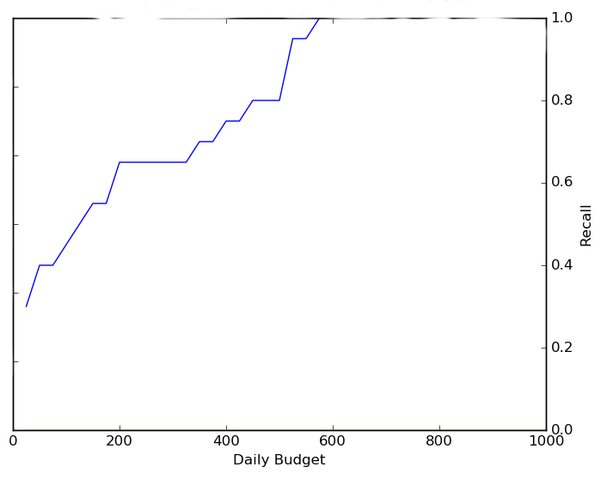
Evaluation Criteria
CR-k: Sum of recalls for all budgets up to and including k
Notes:
Given the assumptions that
we have a fixed daily analyst budget which cannot be carried over from one day to the next,
true positives are rare, and
the cost of a missed detection is substantially larger than the cost of a false positive, we feel that recall-oriented metrics such as CR-k are a more suitable measurement of performance than precision-oriented ones.

Slide 26
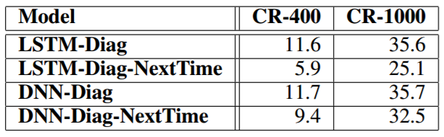
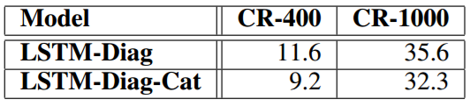
Model configuration comparisons
Including vs Excluding
Categorical Features
Next time step prediction vs
Same time step reconstruction
Notes:
Model performance appears to suffer by including categorical features. Same time step reconstruction outperforms next time step prediction.

Slide 27

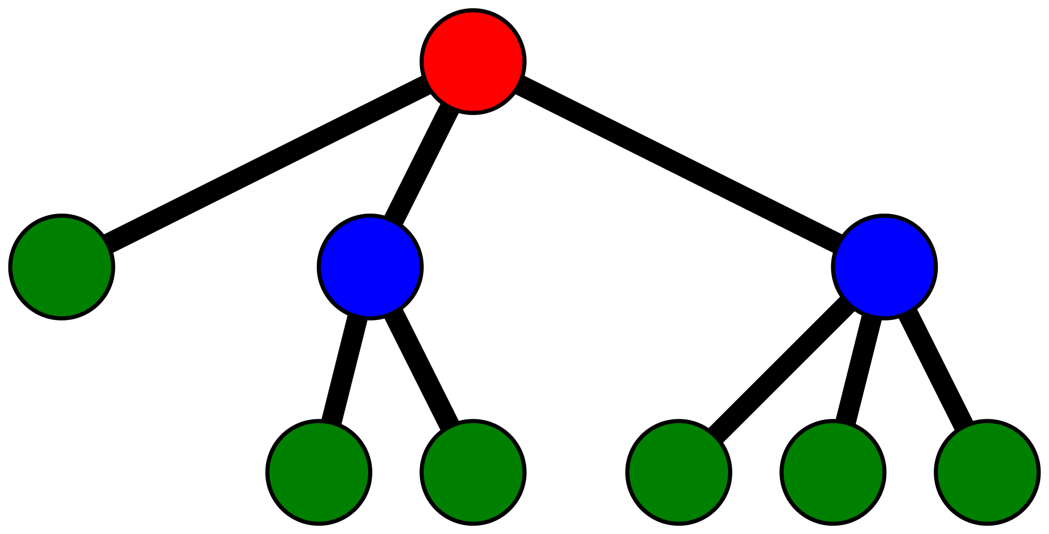
Baseline Models
(
)
=
PCA Reconstruction
One-Class
Support
Vector
Machine
Isolation
Forest
Notes:
We chose three standard unsupervised anomaly detection algorithms as baselines to compare against our model’s performance.
Since none of these algorithms were designed with the online scenario in mind, for each day’s events we train a separate model for all the baselines.
PCA outlier detection is basically a linear auto-encoder. The datapoints for a day are mapped into a lower dimensional space using a PCA transform and then mapped back to the original space by the pseudo-inverse transform.
Isolation forest uses a collection of random decision trees to partition the days events from each other. The shortest average path for a data point to become isolated from the rest of the points is the most anomalous event.
One class support vector machines are an unsupervised variant of support vector machines where outliers are found closest to the origin after the svm mapping to the new space.

Slide 28
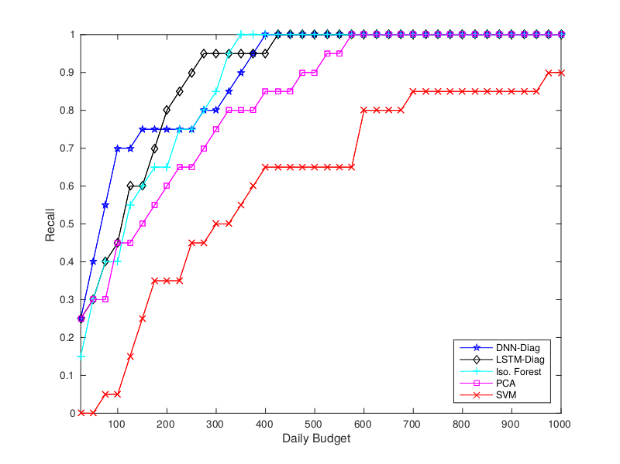
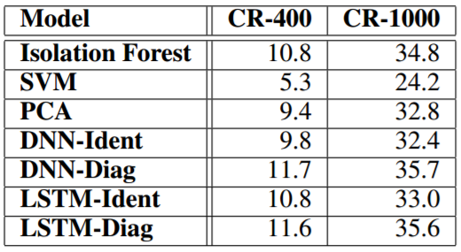
Dnn vs Rnn vs Baselines
Notes:
Both the RNN diag and DNN-diag models outperform all the baselines although iso-forest performs pretty good as well.

Slide 29
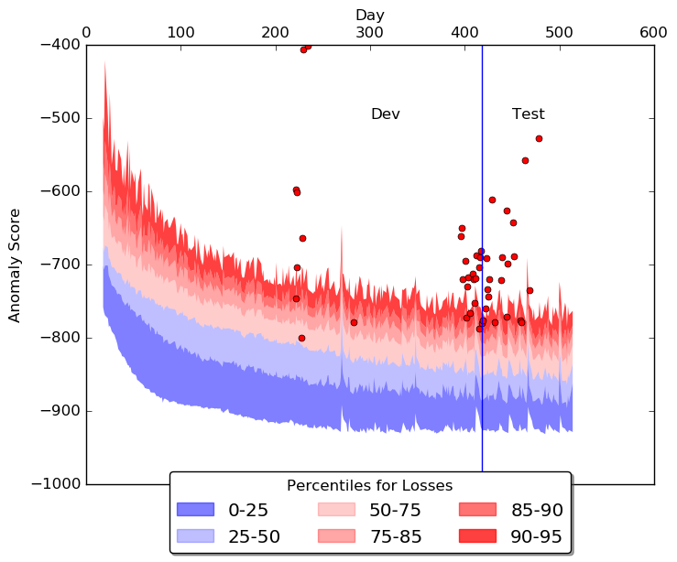
Best results: DNN-diag
Notes:
On the left is a graph of the distribution of anomaly scores as a function of time. The red dots are plotted anomaly scores for labeled instances of insider threat in the data. The blue line separates the dev and test split on days. To the right are histograms of the rank and percentiles which insider threat events fall in according to the model. Notice that there is a noisy “burn in” period where the model is initially learning some notion of normal. Also most insider threat events fall above the 95th percentile for anomaly score demonstrating the model’s ability to effectively filter analyst workload.

Slide 30
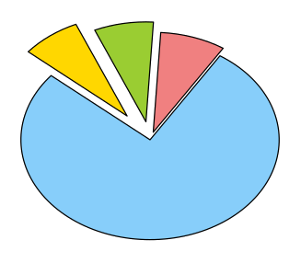
Interpretable Assessments
Write to a globally uncommon file locally 12pm-6pm
Copy to a globally
Uncommon file from
Removable media
6am-12pm
7.4%
Write globally
Uncommon file
locally 6pm-12am
7.4%
8.2%
Day 418
True Positive
77.0%
Other
Decomposed negative log probabilities provide insight into anomaly score

Slide 31
Outline
Data processing and feature extraction
Neural networks and our model
Experiments and results
Takeaways and Continuing work

Slide 32
Takeaways
Online unsupervised deep learning architecture
Interpretable assessments
System meets constraints of the online scenario
Assessments in real time
Bounded memory requirements
System outperforms standard anomaly detection techniques
Approach is applicable to a more general class of problems
Notes:
We developed a system employing an online deep learning
architecture that produces interpretable assessments of
anomaly for the task of insider threat detection in streaming
system user logs.
In our evaluation using the CERT Insider Threat v6.2
dataset, our DNN and LSTM models outperformed three
standard anomaly detection technique baselines (based on
Isolation Forest, SVMs and PCA).

Slide 33
Continuing Work
Explore effectiveness on new data sets
Improve model performance through normalization
Front end: Input normalization
Mid end: Batch/Layer Normalization
Back end: Full covariance prediction
Improve model performance through resampling data
Explore event-wise input to RNN model
Eliminate independence assumption

Slide 34
Thank you
Questions?

Slide 35
Inside an LSTM Layer
h_{t+1}
×
+
c_{t}
c_{t+1}
Forget
Gate
tanh
×
σ
σ
Input
Gate
tanh
σ
×
Output
Gate
W_{f}
M
W_{i}
M
W_{C}
M
W_{o}
M
h_{t}
h_{t+1}
Input
Elementwise multiplication Matrix Addition Matrix multiplication
Elementwise sigmoid Elementwise tanh
×
+
M
σ
tanh
Notes:
Aaron
Don’t worry, we wont’ be diving into the details of this visual.
In addition to the hidden state, a “cell state” is passed through time
This cell state has no non-linear transformations applied to it, which helps long-term dependencies propagate through the network.

Slide 36


































Stacked LSTM
$$hn,1$$
$$hn,2$$
$$hn,m$$
$$cn,0$$
$$cn,1$$
$$cn,m\text{−1}$$
$$cn,m$$
LSTM Layer n
LSTM Layer n
LSTM Layer n
$$hn,0$$
$$hn,1$$
$$hn,m\text{−1}$$
$$hn,m$$
$$hn\text{−1},1$$
$$hn\text{−1},2$$
$$hn\text{−1},m$$
$$c2,0$$
$$c2,1$$
$c2,m$₋₁
$$c2,m$$
LSTM Layer 2
LSTM Layer 2
LSTM Layer 2
$$h2,0$$
$$h2,1$$
$$h2,m\text{−1}$$
$$hn\text{−1},m$$
$$h1,1$$
$$h1,2$$
$$h1,m$$
$$c1,0$$
$$c1,1$$
$$c1,m\text{−1}$$
$$c1,m$$
LSTM Layer 1
LSTM Layer 1
LSTM Layer 1
$$h1,0$$
$$h1,1$$
$$h1,m\text{−1}$$
$$h1,m$$
$$x1$$
$$x2$$
$x$_{m}
Notes:
Aaron
We mentioned before we were training a single RNN on multiple streams, one stream per user. This shows how we pull it off.
We have this data structure that keeps track of the last states of the network for each individual user.
When we see log lines come in for say user k, we reach into our data structure, pull of the saved states for user k, and load them into the network.
The current portion of the user sequence is then few through the network and the final states of the network are then saved in the data structure in the slot for user k.

Slide 37
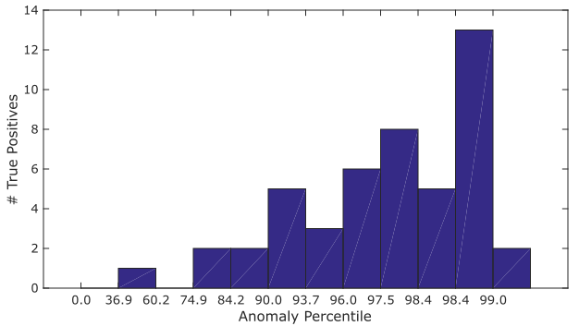
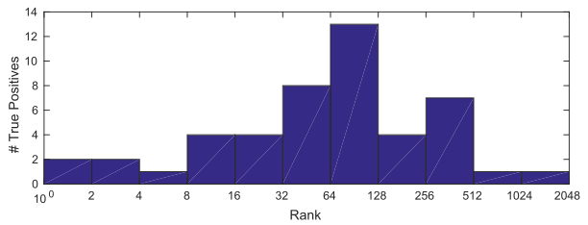
Best Results: DNN-diag

